Slide 1
Get noticed
Getting the job
ACME soft skills training

Slide 2
Review
What did we go over last class?
Applied Math Power:
The importance of this field in the world economy
Jobs you’ll be looking for

Slide 3
Today
Objectives:
Learn to value and sell your skills with STAR
Practice STAR in a fictitious context, then a real context
Consider and practice selling your skills while networking (STEM Fair)

Slide 4
Get noticed
We’ve determined that this is an awesome field to be in. So….now what?
How do you actually get that job?
How do you go from having skills to using those skills to make money?

Slide 5

Notes:
Video: https://www.youtube.com/watch?v=w21cmT-T9H8
This lesson focuses on that part of job-getting

Slide 6
Valuing your skills

Slide 7
Your skills
First, you need to know your skills and be able to communicate them effectively to others:
Verbally (networking & interviewing), and
In writing (resume & cover letter)
Today’s focus will be on talking about your skills in interviewing and networking.
Next week, we will practice applying this to resumes and cover letters.

Slide 8
activity
Individual: make a list of 3-5 things that you know you do well
Consider: when was I at my best? What was I doing?
(Duration:1-2 minutes)
Group: everyone write those 5 things on the board (whiteboard, chalkboard)
(Duration:1-2 minutes)

Slide 9
Discussion
Consider: what “themes” do you see on the board?
Do you see any patterns?
Take-away: ACME students have distinct skills that are useful to employers
Problem: selling these skills can be a challenge – and not just for ACME students

Slide 10
Small group activity
Knowing what you do well is one thing – now, how will you sell it?
Activity: arrange yourselves into groups of 2 (if there is an odd number, the teacher can participate; if not, the teacher facilitates and observes)
Sell the other person on your skill!
Make it catchy, believable, persuasive, etc.
(About 1 minute per person)

Slide 11
Activity review
What happened?
Was it easy to talk about your skills? Why, or why not?
(it is assumed that it was indeed difficult for them to up and talk about their skills)
Take-away: it’s easier to talk about your skills when you have a predetermined strategy for doing so
The strategy we will learn is called STAR

Slide 12
STAR

Slide 13
STAR
STAR is a powerful, simple tool to help you share your skills. It stands for:
Situation: Who, what, where, when, how
Task: The task you had to complete, including challenges and constraints
Action: What you did to complete the task
Result: What you achieved and learned from the experience
It’s a way of breaking down something that you do well, into a result which an employer can use. Essentially, it’s systematic problem-solving.

Slide 14
Application Activity
Let’s break apart the story of something we all likely know very well – the characters and story from the Lord of the Rings saga
If you don’t know Lord of the Rings well, frankly I’m just sad for you.
While watching the following video consider the situation, tasks, actions, and results from the point of view of each character in the film clip
Notes:
Let’s have the students break apart the story of something they likely know very well – LOTR

Slide 15
Notes:
https://www.youtube.com/watch?v=TrJJ6ncp1fc

Slide 16
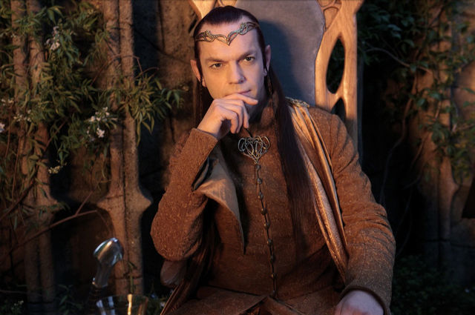
S – Situation
What’s the situation from Elrond’s perspective?
Photo from http://lotr.wikia.com/
Notes:
This might seem overly simplistic, but encourage the students to play along – added complexity comes in a bit

Slide 17
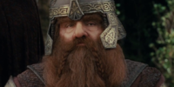
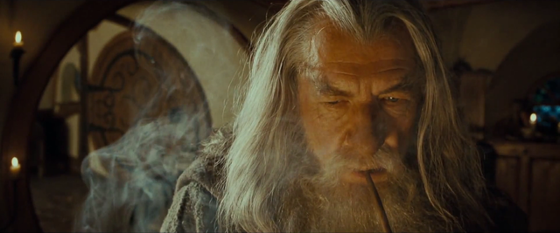
T – task
What tasks were needed from:
Elrond’s perspective?
Gimli’s perspective?
Gandalf’s perspective?
How were these tasks related? Disparate?
Photos from http://lotr.wikia.com/wiki/File:Gandalf..._Pondering.png

Slide 18
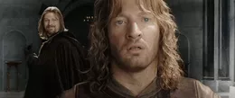
A – action
What actions were taken by:
Elrond?
Boromir?
Faramir?
Denethor?
How did Boromir’s actions influence Faramir’s? Denethor’s?
Photo from http://lotr.wikia.com/wiki/File:Denethor%27s_vision_of_Boromir.jpg

Slide 19


R – result
What results were achieved by:
Elrond?
Frodo and Sam?
Aragorn, Legolas, and Gimli?
Merry and Pippin?
How were the results achieved by these parties convergent? Divergent?
Photos from http://lotr.wikia.com/

Slide 20
STAR stories
STAR is most effective when shared like a story, one part flowing to the other
Using a story allows you to convey specifically and systematically what your role was in finding a solution to a difficult situation.
Thus, potential employers (for example) can see how what you did might be replicated in their environment.
Let’s try this now – but still in the LOTR context

Slide 21
Example
Instructor: share a prepared STAR story about a time when you did something well. For example:
“I once had ten used 50-gallon drums of honey that needed to be cleaned, and I was very tired and they had to be cleaned with a hot-water pressure water. I knew that it would be difficult, but I placed my responsibility before my personal feelings. I worked hard and finished the job thoroughly before my deadline, and then returned to my boss to report on what I’d done.”

Slide 22
Further application
Get together with the same partner and practice telling a STAR story
Share a STAR story from the LOTR saga from the perspective of a character of your choice, as if pitching your skills to one of two potential employers: Sauron “the Abhorred”, or Elrond, Lord of Rivendell (3-5 minute activity)
Anyone not conversant in LOTR may choose a character from Star Wars, Dr. Who, Harry Potter, etc.
If you’d like, show your understanding of this skill by try picking a more obscure character, like the Witch King of Agmar or Grima Wormtongue
Feel free to be as specific as you’d like (e.g, “After I raised my staff in the air, I wielded the Flame of Anor in a spectacular protective fashion, fending off the Balrog long enough for the company to escape.”; “Then I chased down the invisible vermin and bit off his finger”; etc.)

Slide 23
reflection
How did it go?
Did your understanding of how to use STAR increase?
What would make your pitch more effective?
Poll the class: who gave the most convincing pitch?
Have the students vote for the favorite and have him/her share for the class (extra credit?)

Slide 24
Personal application
Now that the concept is firmly cemented in your minds let’s apply STAR to a “story” from your own lives:
Consider something that you do well (preferably at work), and think of a time when you applied it with success
Share your story with a partner

Slide 25
Reflection
Was this better than the first time we did this?
Why, or why not?

Slide 26
Bottom line
Use STAR to be specific and categorical in describing your skills and successes

Slide 27
networking

Slide 28
Networking
Discuss:
What comes to your mind when you think of networking?
Can you think of examples when networking has opened up opportunities for you?
How do you think networking could benefit you in future?
Instructor: Have a few examples in mind to share, in case class members don’t readily share their own

Slide 29
Networking
Essentially, the purpose of networking is two-fold:
Other people have jobs / job openings—draw on your network to help you find a good job
Other people have distinct skills that you may not have—reach out to people in your network to be on your team or help you do your job
If you don’t network, you might be very smart, but very broke

Slide 30
activity
Middle-Earth Mingling
Move the desks to the sides of the room. Have the students grab a nametag and write the name of a character (any one) from LOTR – either good, or bad. They will act as that character with specific situations in mind. The students will mingle with each other as if in a networking situation, doing their best to share their stories with each other and convince others to join their ranks. Instruct students to be forthcoming with their character’s distinct skills, and to also be on the lookout for other characters whose skills compliment their character’s.
Each student will have 5 blank pieces of paper. Instruct the students to give a piece of paper to a student who sells their character and his/her actions very well. At the end of the activity, the student with the most paper wins (bragging rights, or candy, or whatever you want) and is pronounced “Lord of Moria”, “Wielder of the Flame of Udun”, or whatever title they deem appropriate.
Again, characters from another series can be substituted if a student is not conversant with LOTR
Notes:
NOTE THE SUPPLIES NEEDED FOR THIS ACTIVITY

Slide 31
Reflection
Who won?
Why did they win?
What did you do well?
What could you have done better?

Slide 32
Assignment
Visit the STEM fair and talk with at least 3 recruiters
Sell your strengths
Learn about what they do
Evaluate your pitch, make it better

Slide 33
Review
Objectives:
Learn to value and sell your skills with STAR
Practice STAR in a fictitious context, then a real context
Consider and practice selling your skills while networking (STEM Fair)

Slide 34
Additional resources
Star stories:
https://www.youtube.com/watch?v=0nN7Q7DrI6Q
http://lifehacker.com/5960201/use-the-star-technique-to-ace-your-interviews
http://www.huffingtonpost.com/alan-carniol/inside-the-star-interview_b_3310122.html
https://careerservices.wayne.edu/behavioralinterviewinfo.pdf
How to Ace an Interview: https://www.youtube.com/watch?v=DHDrj0_bMQ0

